Slide 1
PSYCHOLOGICAL DISORDER PROFILING
THROUGH
SOCIAL MEDIA MINING
RECENT TRENDS IN SOFTWARE ENGINEERING
Anirudh Bhattacharya
Pranav Nimbalkar

Slide 2
Contents
Social Media Uses
Effects Of Social Media
Time to Analyze our Online Behavior
Psychological Disorder Profiling
Sentiment Analysis - A Preliminary Step
Social Media Platform – Twitter
Procedural Journey Of This Research
References
Q & A

Slide 3
Social Media Uses
Entertainment
Communication
Marketing
Discussion Forums
SOCIAL MEDIA
Sales
Blogging
Innovation

Slide 4
Effects Of Social Media
SOCIAL MEDIA
How many of us use it?
How often do we use it?
Are we only using it? OR
Are we also getting used by it?
Want to Influence the world through digital platforms ?
What about the reverse impacts ?

Slide 5
Time to Analyze our Online Behavior
More Impulsive
Jumping to conclusions
Following trends over Rational thinking?
Trolling - Are we loosing the essence of Dissent?
Emotional Uncertainty? Or Increasing Psychological Instability?
Need of Psychological Disorder Profiling

Slide 6
Psychological Disorder Profiling
Analyzing our online content (ex:- Text)
“A picture is worth a thousand words” by Fred R. Barnard
How about computing those words to identify the sentiment?
Determining different types of disorders
OCD [Obsessive Compulsive Disorder]
Anxiety
Suicidal Tendency
Depression

Slide 7
Sentiment Analysis - A Preliminary Step
Textual Statements
Categorizing into sentiments
Negative
Neutral
Positive
I would rather die than have
to keep living this way.
It won't get better.
I am okay with the way
things are going in my life
I am so excited about the new
Promotion I am about to get in office
Affinity
Score
-5
5
0

Slide 8
Social Media Platform - Twitter
Most Popular micro blogging Site
Tweets are crisp and to the point
Hashtags “#” helps in quick classification of raw data collection

Slide 9
Procedural Journey Of This Research
Data Collection
Twitter Tweets
Data Cleansing
Natural Language Processing Toolkit
Model Training
Machine Learning Implementation
scikit learn
Validating Results
Data Visualization tools

Slide 10
References
Books:
Opinion Mining and Sentiment Analysis
- by Bo Pang & Lillian Lee
Mining Text Data
- by Charu C. Aggarwal & ChengXiang Zhai
Research Papers:
A Framework for profiling and friend prediction on Twitter
- by Wen Zhang, Saifullah Ansari.
SENTIMENT ANALYSIS OF SARCASTIC SENTENCES OF TWITTER DATA
- by Garima Tripathi, Mosd. Saif Wajid.

Slide 11
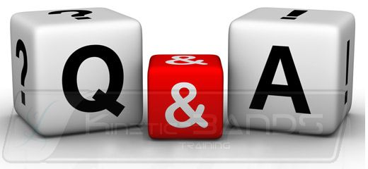
Image Source - https://kinetic-bands.eu/articles/questions_and_answers/

Slide 12
Thank You

